Slide 1
Genome Annotation
Alexey V. Zimin
BME580.417(707)

Slide 2
Genome annotation
Protein coding gene annotation solves two main problems:
Locate transcripts
Locate protein coding regions (Open Reading Frames, or CoDing Sequences) within transcripts
Other kinds of annotations:
Long non-coding RNA annotations
Repeat annotation
Short RNA annotations (tRNA, miRNA, etc)

Slide 3
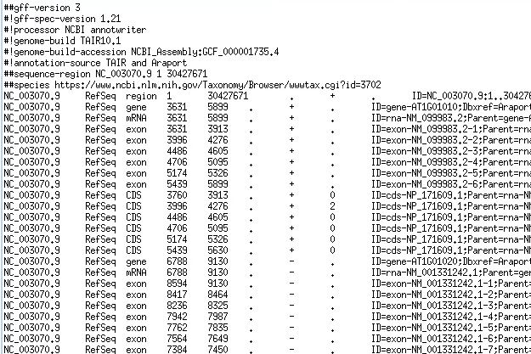
Protein coding and lncRNA annotation
Protein coding and lncRNA annotation locates on the genome the coordinates of:
genes
transcripts
protein coding sequences
Usually reported in GFF3 or GTF format

Slide 4
Gene structure on the genome
Genome
gene
exon
exon
Genome
exon
exon
CDS
3’ UTR
Genome
5’ UTR
CDS
CDS
CDS
Genome
exon
exon
exon
exon
exon
CDS
3’ UTR
Genome
5’ UTR
5’ UTR
5’UTR
CDS
CDS
Start codon (ATG)
Stop codon (TAA,TAG,TGA)

Slide 5
Gene structure in transcript(spliced) coords
gene
transcript or mRNA
exon
exon
exon
exon
exon
5’ UTR
5’ UTR
5’UTR
CDS
CDS
CDS
3’ UTR
transcript or mRNA
exon
exon
exon
exon
5’ UTR
CDS
CDS
CDS
CDS
3’ UTR

Slide 6
GFF/GTF files provide a map for all known genome features
Column | Description
Seqname | Name of chromosome, scaffold or contig
Source | Name of the datasource
Feature | Feature type (e.g. gene, exon, transcript, CDS, five_prime_UTR)
Start | Start position of the feature
End | End position of the feature
Empty | ‘.’
Strand | Defined as + (forward) or - (reverse)
Frame | Either ‘0’, ‘1’, or ‘2’ - indicating reading frame by base position
Attribute | A semicolon separated list of other info about the feature
GFF has many versions, but the two most popular are:
GTF2 (Gene Transfer Format): https://mblab.wustl.edu/GTF2.html
GFF3 (Generic Feature Format): https://github.com/The-Sequence-Ontology/Specifications/blob/master/gff3.md

Slide 7
Locating transcripts on the genome
Two ways to find protein coding and long non-coding RNA transcripts on the genome:
Align RNA-seq data(HISAT,STAR) + assemble(StringTie)
Ab initio (AUGUSTUS, SNAP, GeneMark)
Only for protein coding transcripts, only find CDS (CoDing Sequence)
Other RNA annotations:
Repeat annotation (RepeatFinder)
Short RNA annotations (tRNA, miRNA, etc) -- (tRNAScan, Infernal)

Slide 8
Challenges in annotation
Alternative isoforms:
Identifying all of them from the data can be algorithmically challenging
Not all isoforms are expressed in all tissues under all conditions, which requires many RNA-seq experiments to produce comprehensive annotation
Coding vs. non-coding, and if coding where is the CDS:
How do we tell which assembled transcripts are coding for functional proteins?
Typically one can find several different ORFs in different frames on a transcript -- which frame is the right one?

Slide 9
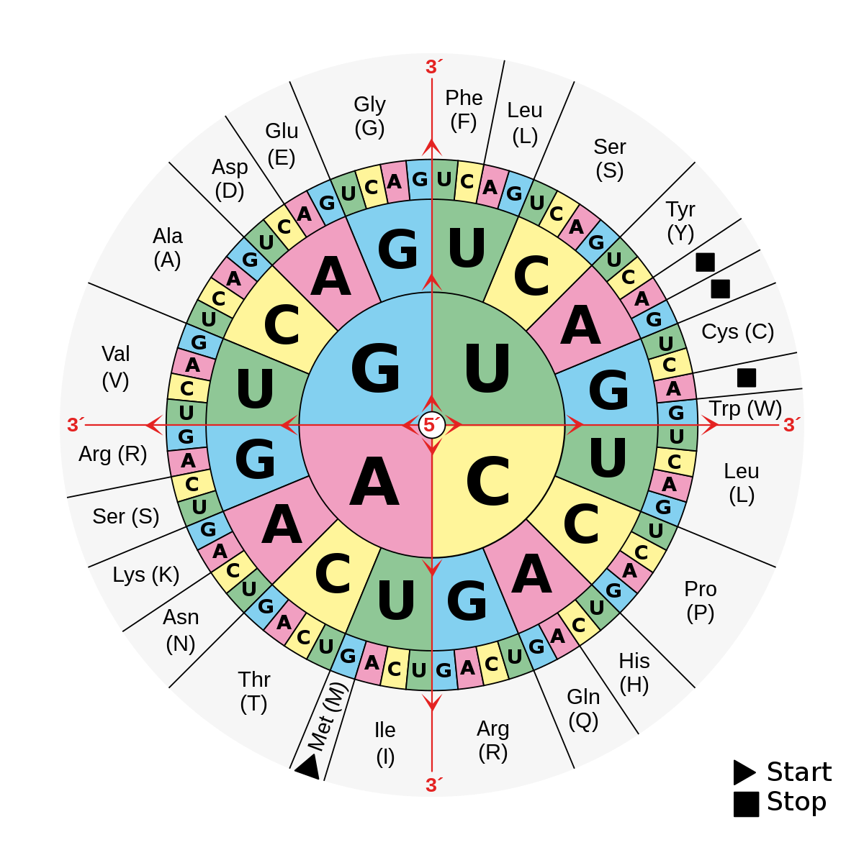
Recall amino-acid translation table

Slide 10
Where is the ORF?
Finding the ORF requires:
Identifying the frame (out of 3 if strand is known)
Identifying start
The two conditions above specify the stop Sequence: AACATGGGATGGAATAATTCGTGAAG Frame 0: AAC ATG GGA TGG AAT AAT TCG TGA AG Protein: M G W N N S * Frame 1: AA CAT GGG ATG GAA TAA TTC GTG AAG Protein: M E *

Slide 11
How do we find the right ORF?
ORF finder software -- TransDecoder, input spliced transcripts, output ORFs
Makes mistakes in cases when there are two ORFs of comparable length in two different frames
Will find ORFs in non-coding transcripts
Ab initio gene finders -- AUGUSTUS, GeneMark, SNAP
Work on unspliced DNA
Many false positives
CDSs they find may not be intron-chain compatible with transcripts -- which one is correct?

Slide 12
How do we find the right ORF?
Protein homology:
Proteins are conserved over large evolutionary distances
Proteins can be aligned to the DNA:
Alignments must be done in Amino Acid space because DNA->Protein is unique, but Protein->DNA is not
Translate genome to AA in six frames (three forward and three reverse) and then align AA sequences
Can use Smith-Waterman, minimizers, suffix arrays
Once AA are aligned, can go back to DNA coordinates
Protein alignment can provide the ORF and can tell which transcripts are protein coding

Slide 13
What is an annotation pipeline
Annotation pipeline is a software product that employs a collection of programs that locate functional elements on the genome
Input: Genome, RNA-seq data, Protein sequences from related species
Output: Gene annotation in GFF/GTF format

Slide 14
Eukaryotic annotation pipelines
Evidence-based (alignments of transcripts and proteins):
EviAnn by Zimin et al.
Ab initio-based
BRAKER3 by Borodovsky et al.
Mix of evidence and ab initio:
MAKER{2,3} by Yandell et al.
EGAPx by NCBI

Slide 15
Test data sets
A. thaliana, D. melanogaster:
5-6 RNA-seq experiments
Proteins from 5-10 close relatives
Compare EviAnn, BRAKER3, MAKER2+SNAP, EGAPx
EviAnn, BRAKER3 and EGAPx: aligned BAM files + proteins
MAKER2: transcript assemblies by StringTie2 as evidence + proteins

Slide 16
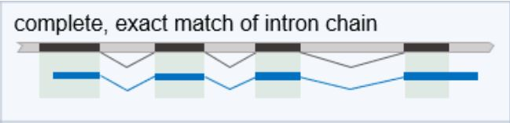
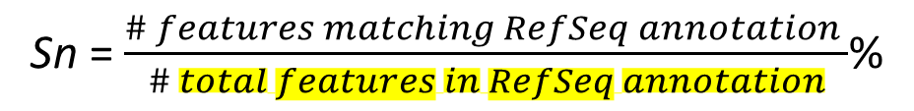
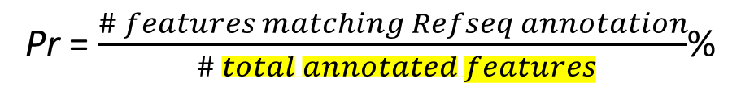
Evaluations
gffcompare to RefSeq annotations of:
-- protein coding genes
-- long non-coding RNA’s
Sn = $\frac{\# features matching RefSeq annotation }{\# total features in RefSeq annotation}$%
Pr = $\frac{\# features matching Refseq annotation}{ \# total annotated features}$%
Evaluate quality of transcripts, gene loci and proteins

Slide 17
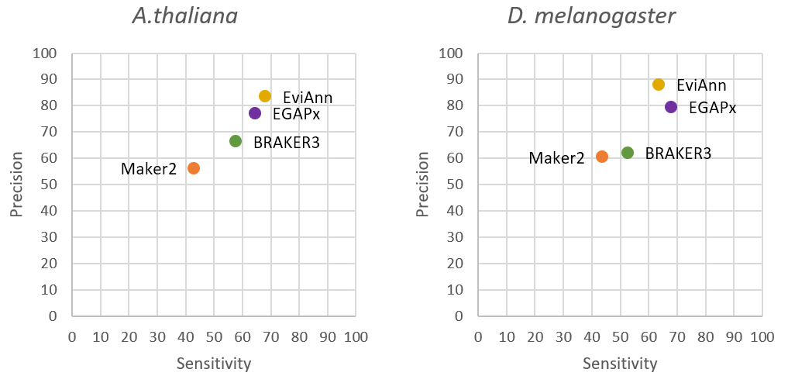
Evaluation of genes (gene loci)
A gene or gene locus counts as annotated correctly if a transcript or a CDS match the reference at the locus

Slide 18
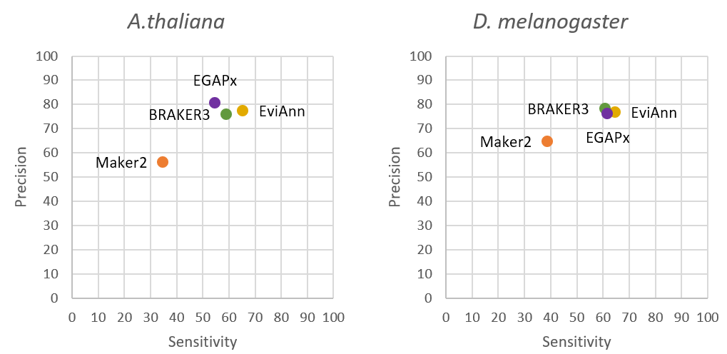
Evaluation of proteins
A protein is correctly annotated if CDS matches exactly to a reference protein.

Slide 19
EviAnn timings (24-core Intel Xeon Gold)
Wall-clock time in hours, excluding the time spent on alignment of RNA-seq data.
 | A.thaliana | D.melanogaster
EviAnn | 0.3 | 0.3
BRAKER3 | 13.2 | 7.3
EGAPx | 6.8 | 8.4
MAKER2 | 168 | 34

Slide 20
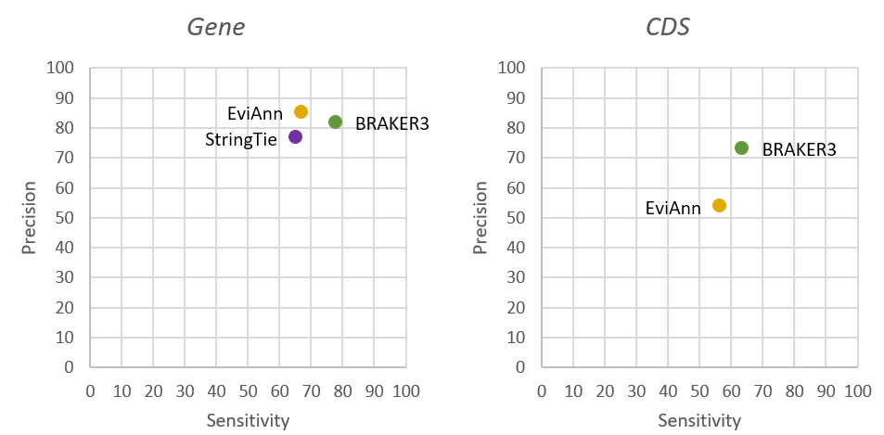
EviAnn Shortcomings
No proteins from close relatives (neighboring taxonomic Tribe of Family) available -- BRAKER3 will work better, e.g. A.thaliana order removed:

Slide 21
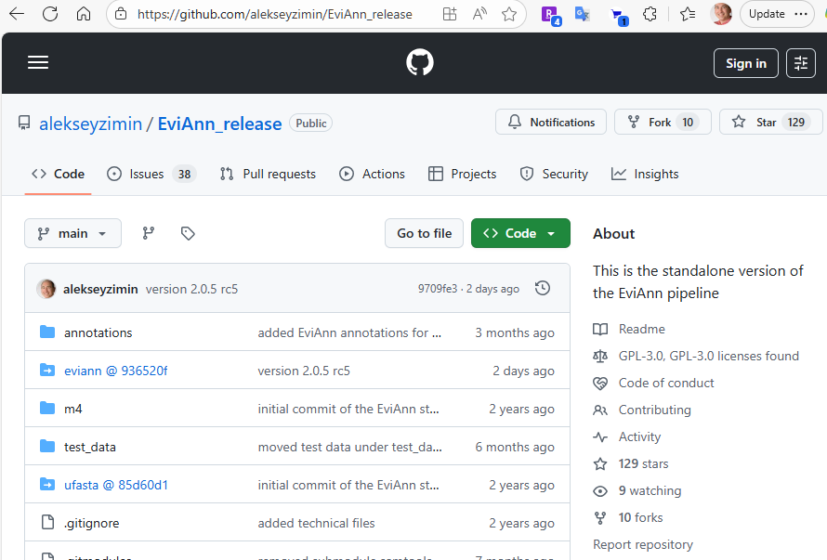
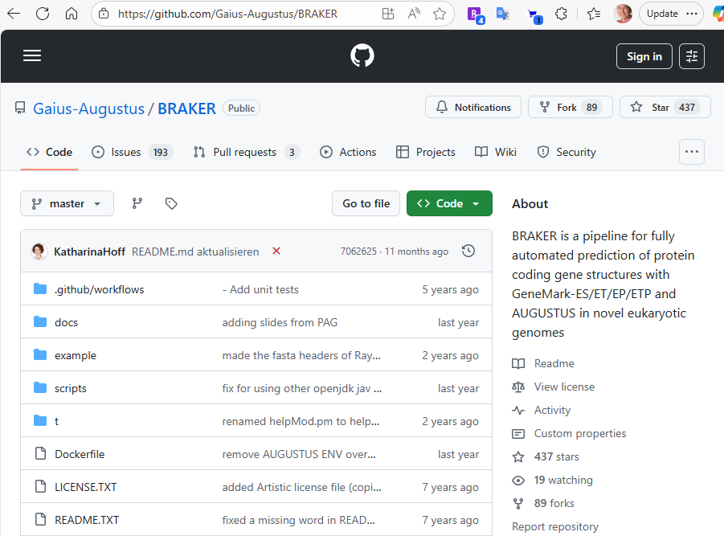
Obtaining EviAnn and BRAKER3
Both programs available from Bioconda:
conda install eviann
conda install braker3
Or from github:

Slide 22
Summary: how to annotate a eukaryotic genome
Sequence >5 RNA-seq datasets from different tissues
Check NCBI taxonomy for related species’ proteins:
Search for species in NCBI Taxonomy
Use EviAnn if >~ 400K proteins are available from species of neighboring Tribe or Family
Use BRAKER3 if ~< 400K proteins are available from species of neighboring Tribe or Family
Or you can use both:
Run BRAKER3, then run EviAnn inputting BRAKER3 annotation with -c

